Slide 1
Pizza Sales Analysis Project Using SQL for Data Analysis
Skills: SQL | Data Analysis | Business Insights

Slide 2
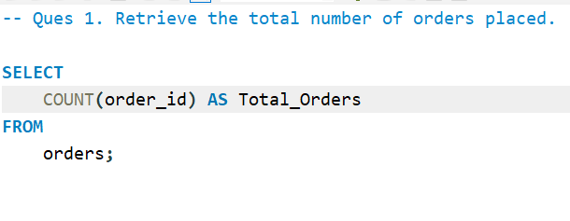


Slide 3
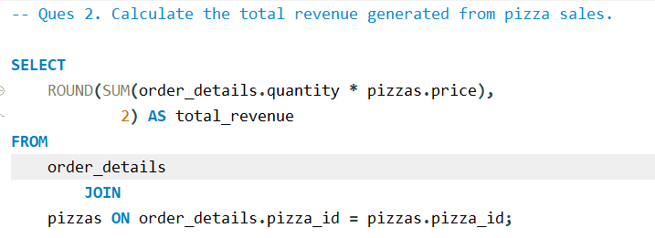
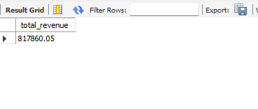

Slide 4

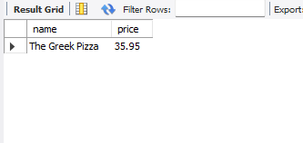

Slide 5

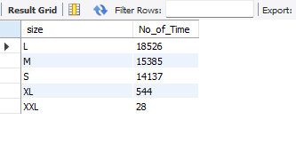

Slide 6
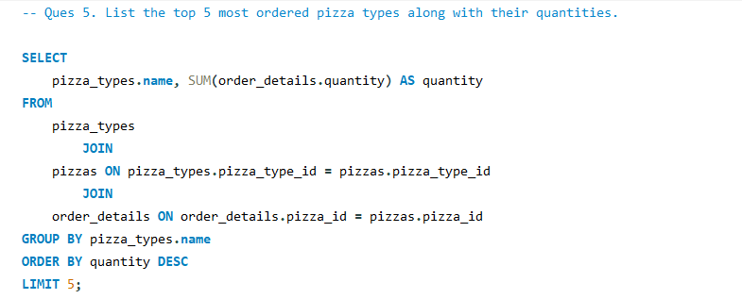
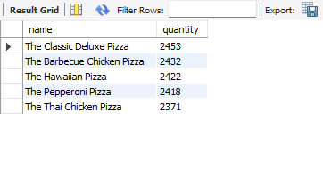

Slide 7
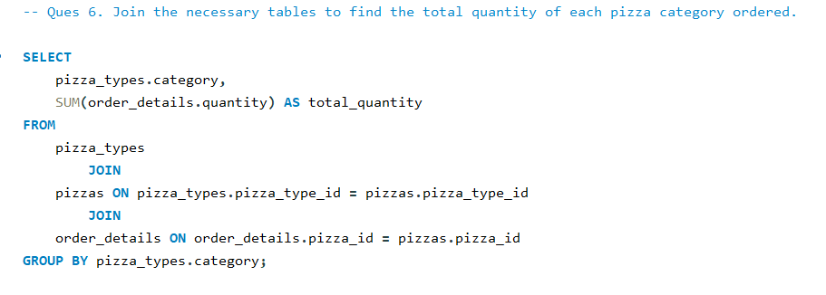
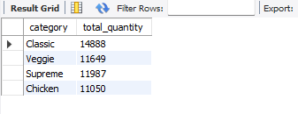

Slide 8

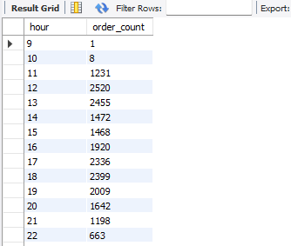

Slide 9

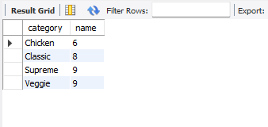

Slide 10

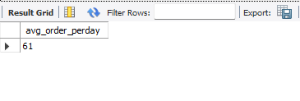

Slide 11

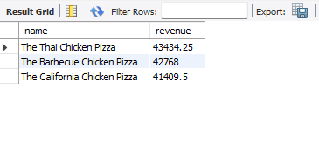

Slide 12
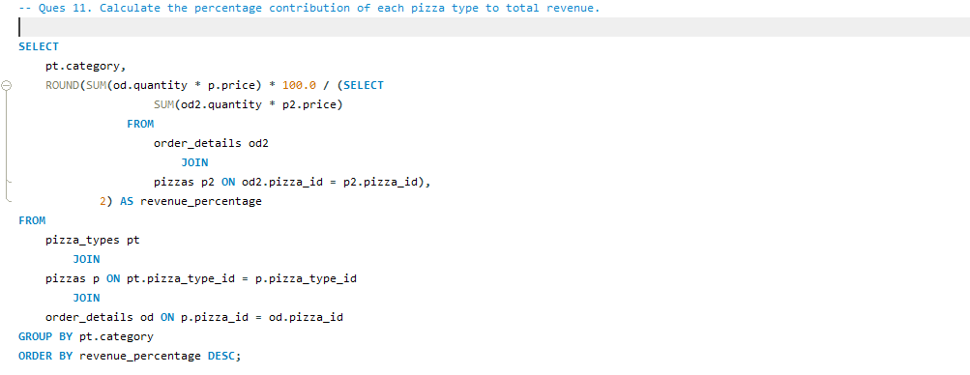
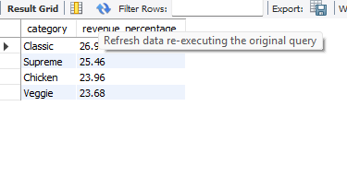

Slide 13
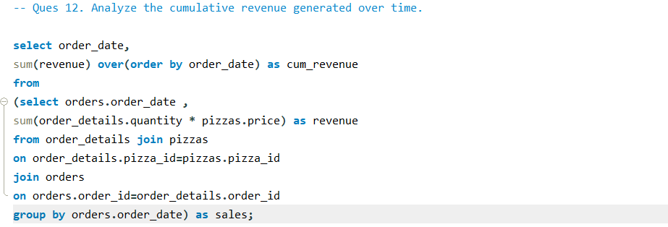
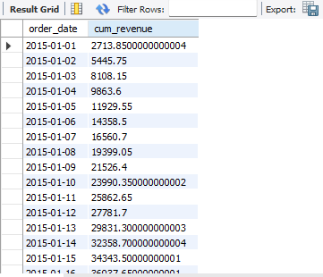

Slide 14
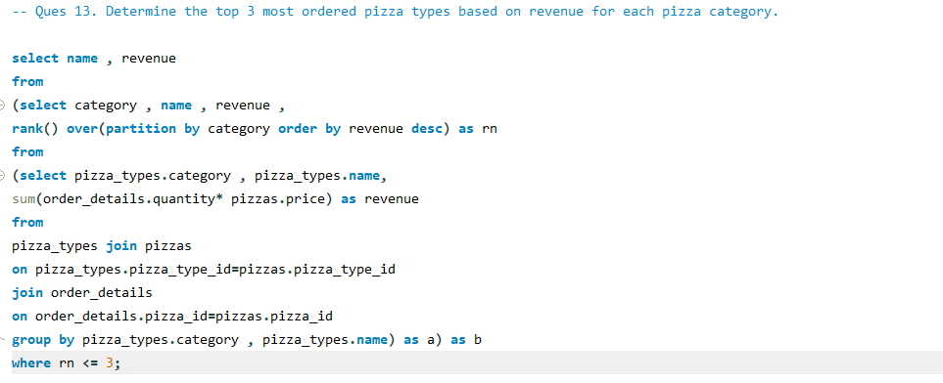
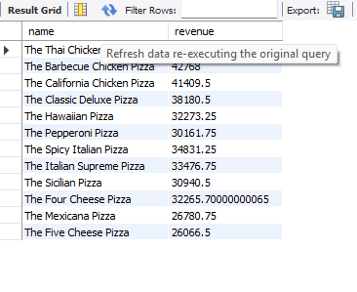

Slide 15
Key Insights & Takeaways
Through this SQL-based Pizza Sales Analysis, I transformed raw transactional data into meaningful business insights.
The analysis revealed that a small number of pizza categories contribute a significant share of total revenue, highlighting clear focus areas for business growth.
Revenue patterns also showed that top-performing pizzas consistently drive overall sales, while low-performing items present opportunities for menu optimization.
By combining joins, aggregations, and subqueries, this project demonstrates how SQL can support data-driven decision-making in real-world business scenarios.

